Slide 1
WITH CSM (R) MARK GERECHT
How to Fill Out the DA Form 4856
Notes:
Mark is available to teach this class to your unit (NCO Professional Development Training) in person. The full version of the class includes additional information including references and case studies. For additional information, write Mark@AskTOP.net

Slide 2
Purpose of Counseling
Praise the Soldier for a Job Well Done!
Set the Soldier up for success going forward
Put the facts on the table
Help the Soldier develop their plan to correct the issue
Notes:
Mark is available to teach this class to your unit (NCO Professional Development Training) in person. The full version of the class includes additional information including references and case studies. For additional information, write Mark@AskTOP.net

Slide 3
Research
Before you start writing do your research
Understand the situation
What are the facts?
What regulations cover this issue?
What is required?
What can be recommended?
How do you set the Soldier up for Success
Notes:
Mark is available to teach this class to your unit (NCO Professional Development Training) in person. The full version of the class includes additional information including references and case studies. For additional information, write Mark@AskTOP.net

Slide 4
Draft the Counseling
Draft your counseling
This counseling is not initially given to the Soldier
Use it as a guide or road map for your counseling session
If you discover new information during the counseling adjust the counseling statement
Give the Soldier the final counseling statement for signature

Slide 5
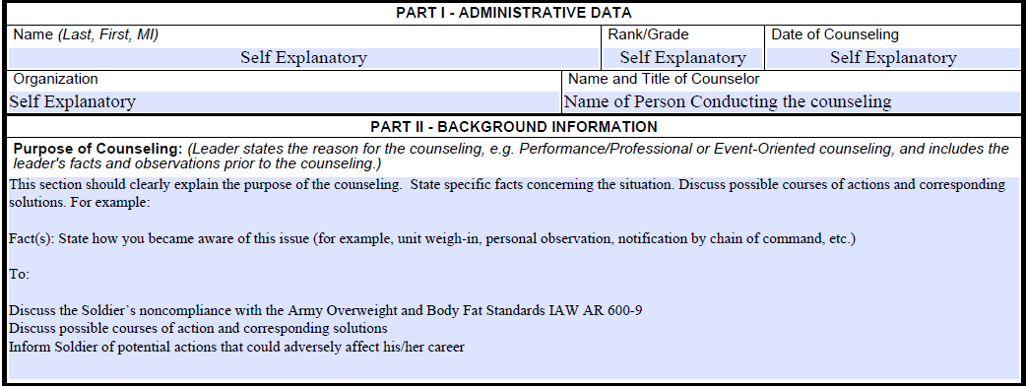
Part 1 & 2 Admin Data & Background Information
Notes:
Mark is available to teach this class to your unit (NCO Professional Development Training) in person. The full version of the class includes additional information including references and case studies. For additional information, write Mark@AskTOP.net

Slide 6
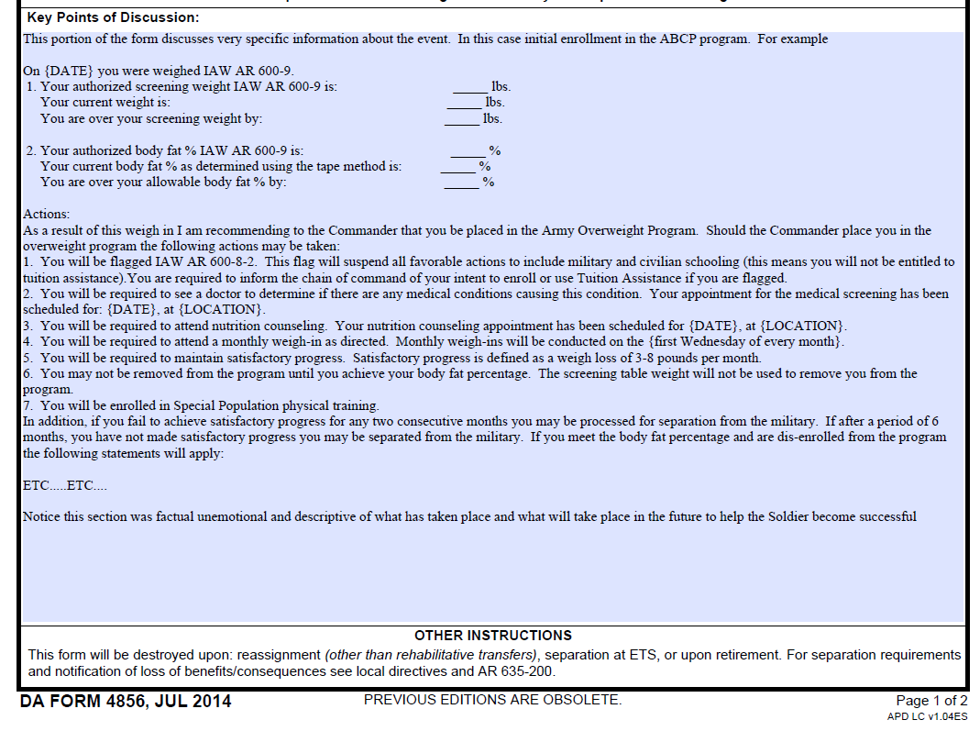
Part 3 Summary of Counseling
Notes:
Mark is available to teach this class to your unit (NCO Professional Development Training) in person. The full version of the class includes additional information including references and case studies. For additional information, write Mark@AskTOP.net

Slide 7
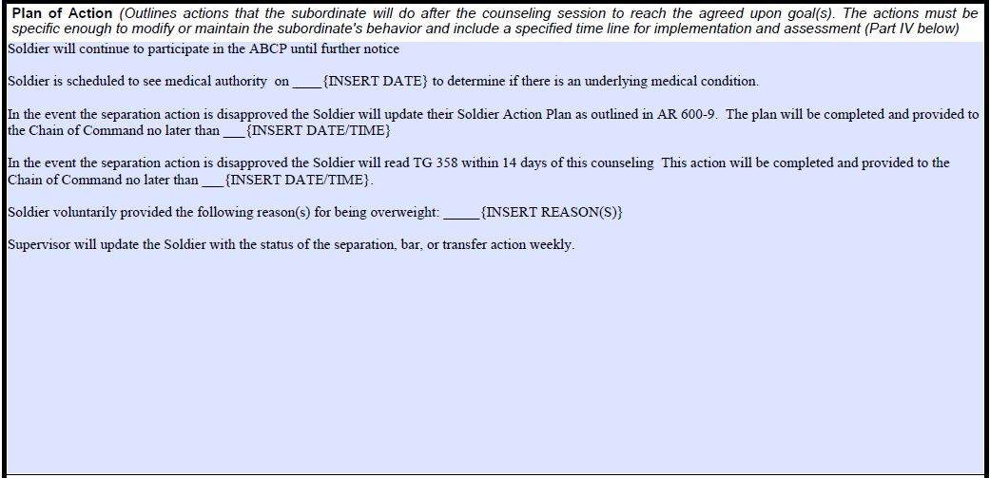
Part 3 Plan of Action
Notes:
Mark is available to teach this class to your unit (NCO Professional Development Training) in person. The full version of the class includes additional information including references and case studies. For additional information, write Mark@AskTOP.net

Slide 8
Part 3 Session Closing
Disagree – What Now!
Backdating
Notes:
Mark is available to teach this class to your unit (NCO Professional Development Training) in person. The full version of the class includes additional information including references and case studies. For additional information, write Mark@AskTOP.net

Slide 9
Part 3 Leader Responsibilities
Notes:
Mark is available to teach this class to your unit (NCO Professional Development Training) in person. The full version of the class includes additional information including references and case studies. For additional information, write Mark@AskTOP.net

Slide 10
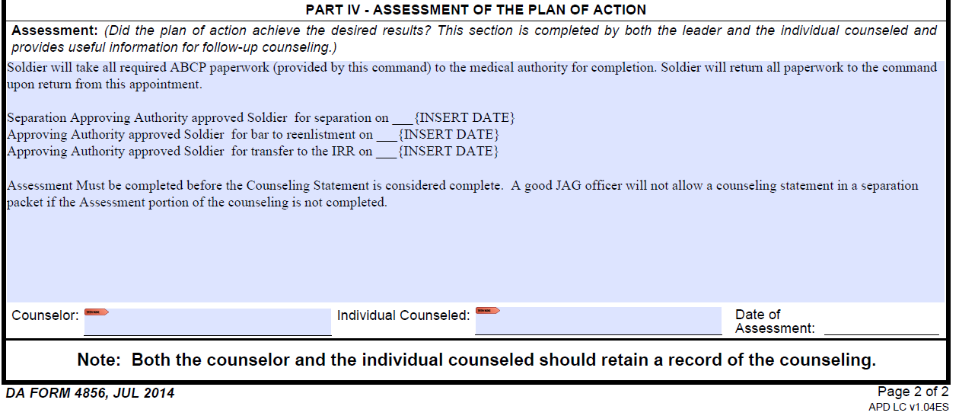
Part 4 Assessments
Notes:
Mark is available to teach this class to your unit (NCO Professional Development Training) in person. The full version of the class includes additional information including references and case studies. For additional information, write Mark@AskTOP.net

Slide 11
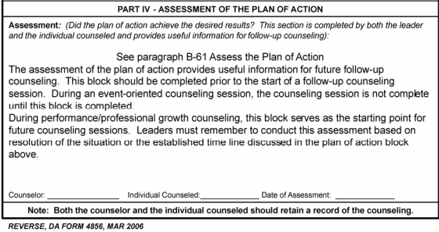
Part 4 Assessments
Must be completed
FM 6-22, Appendix B, Figure B-11, Page B-20 – While now obsolete shows the Army’s intent on how Assessments are to be handled.
Notes:
Mark is available to teach this class to your unit (NCO Professional Development Training) in person. The full version of the class includes additional information including references and case studies. For additional information, write Mark@AskTOP.net

Slide 12
Summary
Research
Draft – Set the Soldier up for success
Counseling
Adjust Counseling Statement
Provide Document for Signature
Assess
Both Counselor and Soldier retain a copy
Notes:
Mark is available to teach this class to your unit (NCO Professional Development Training) in person. The full version of the class includes additional information including references and case studies. For additional information, write Mark@AskTOP.net

Slide 13
FOLLOW US ON FACEBOOK @ ASKTOP & @MENTOR MILILTARY
Visit Our Retail Store:
MENTORMILITARY.COM
For all of your military professional development needs
Notes:
Mark is available to teach this class to your unit (NCO Professional Development Training) in person. The full version of the class includes additional information including references and case studies. For additional information, write Mark@AskTOP.net

